Slide 1


HOSPITALITY ANALYSIS
Group : 4
Thokchom Ajoy Singh
Shalivahan Patil
Anand
Likith

Slide 2
PROJECT OBJECTIVE
We Used MS-Excel and MySQL To Conduct Analysis, Cleaning and Eliminate Duplicates From The Datasets. Then, We Crafted Interactive Dashboards Using Tableau And Power-Bi Tools, Involving Calculations And Measurement Operations
Through this project, We intend to Attrition predication, Workforce Planning, Monitor Hospitality Analysis for compliance with regulations and make data-informed decisions that will drive the success and growth of our business.
To optimize data in the Hospitality sector by leveraging data-driven insights. This project aims to achieve the following key performance indicators (KPIs):

Slide 3
KPI LIST
Total Revenue
Occupancy
Cancellation Rate
Total Booking
Utilize capacity
Trend Analysis
Weekday & Weekend Revenue and Booking
Revenue by State & hotel
Class Wise Revenue
Checked out cancel No show
Weekly trend Key trend (Revenue, Total booking, Occupancy)

Slide 4
DASHBOARDS

Slide 5
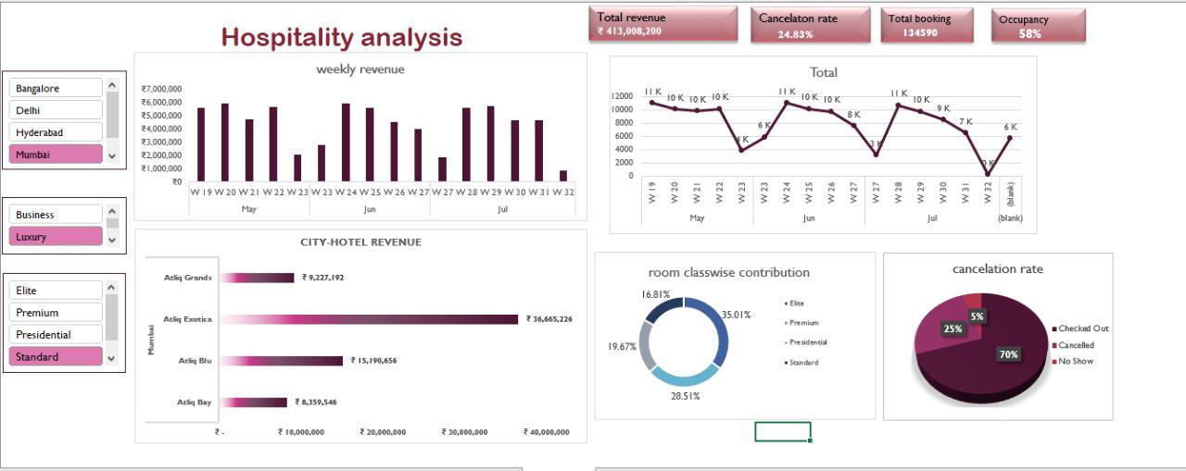
EXCEL

Slide 6
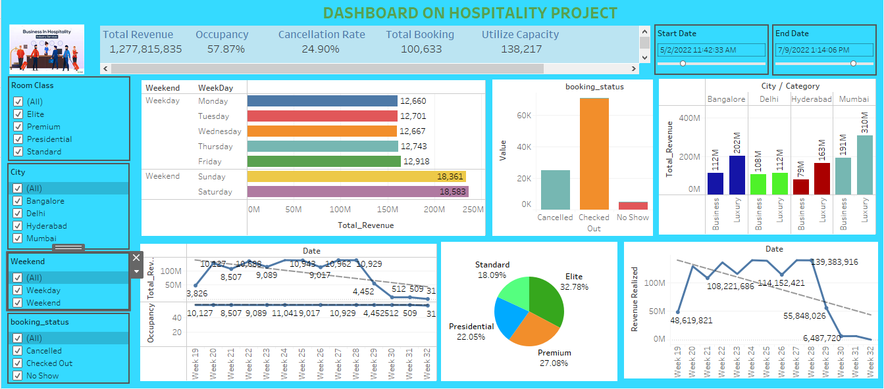
TABLEAU

Slide 7
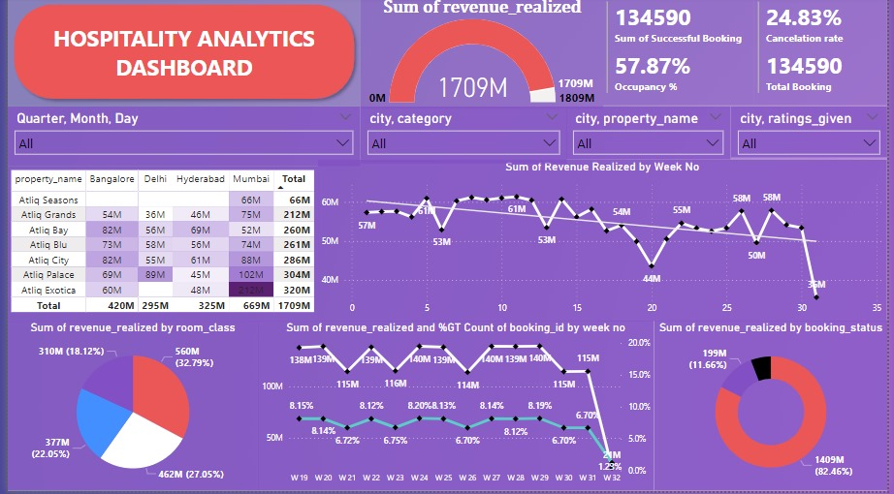
POWER BI

Slide 8
KPI EXPLANATION

Slide 9


Total Revenue: Analyzed trends in total revenue over time to identify periods of growth or decline. Looked for factors influencing revenue fluctuations, such as seasonality, pricing strategies, or marketing campaigns. Occupancy: Investigated occupancy rates to optimize room availability and pricing. Identified peak periods and adjust staffing levels and inventory accordingly to maximize revenue.

Slide 10



Cancellation Rate: Analyzed reasons for cancellations to develop strategies for reducing cancellation rates. This involved improving booking policies, enhancing communication with guests, or offering incentives to encourage booking confirmation Total Booking: Understood booking patterns to forecast demand accurately. Identified trends in booking channels (direct bookings, online travel agencies, etc.) to optimize distribution strategies and maximize bookings. Utilize Capacity: Evaluated how effectively capacity is being utilized to identify opportunities for increasing revenue

Slide 11
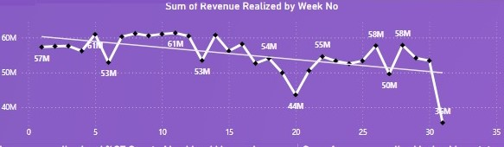
Trend Analysis: Conducted in-depth trend analysis to identify long-term patterns and anticipate future demand. Use historical data to forecast revenue, occupancy, and booking trends, enabling proactive decision-making.

Slide 12
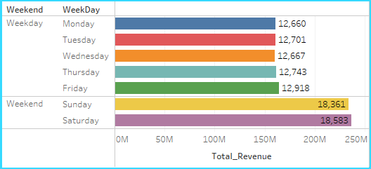
Weekday & Weekend Revenue and Booking: Compared revenue and booking performance between weekdays and weekends to tailor marketing and pricing strategies accordingly. Identify opportunities to drive weekday occupancy or increase weekend rates

Slide 13
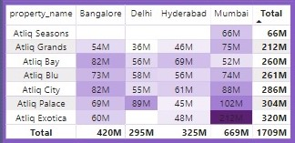
Revenue by State & Hotel: Analyzed revenue performance across different city and individual hotels to identify top-performing locations and areas for improvement. This can help for expansion of business in the future and help to take a decision based on the results.

Slide 14
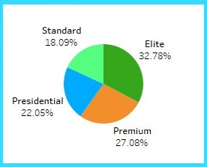
Class Wise Revenue: Segmented revenue by room class or category to understand the contribution of each segment to overall revenue. So that we can understand which segment is contributing less to drive marketing strategy accordingly.

Slide 15
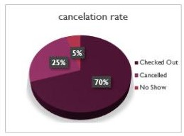
Checked out Cancel No show: Analyzed the overall percentage of checked-out, cancellations and no-shows to identify revenue loss. Implement strategies such as prepayment policies or automated reminders to reduce no-show rates

Slide 16
CONCLUSION
In conclusion, the hospitality industry presents numerous opportunities for growth and optimization, as evidenced by the various key performance indicators (KPIs) such as total revenue, occupancy, and cancellation rates. By leveraging data analysis and insights from these KPIs, hotels can make informed decisions to enhance revenue streams, improve operational efficiency, and enhance guest satisfaction.
Ultimately, by continuously monitoring performance metrics, staying abreast of industry trends, and adapting to changing market dynamics, hospitality businesses can thrive in an increasingly competitive landscape and deliver exceptional experiences to guests while maximizing profitability.

Slide 17
THE END

